Slide 1



Murphy: Performance Diagnosis of Distributed Cloud Applications
Vipul Harsh¹, Wenxuan Zhou², Sachin Ashok¹, Radhika N. Mysore³,
P. Brighten Godfrey^{1,2}, Sujata Banerjee³
SIGCOMM, September12, 2023
Notes:
Vmware research is highlighted
Make sure that every slide has page numbers
Put a citation for all the schemes

Slide 2
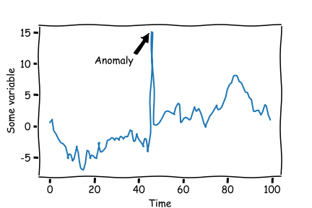
Troubleshooting incidents in networked-systems is hard
Large number of entities
  VMs, flows, switches, hosts etc.
  complex dependencies between entities
Monitoring data is coarse-grained
  entities have metrics (e.g. VMs have CPU usage)
ToR Switch
Flow 1
Frontend
Server
Flow 3
Flow 2
VM
VM
VM
VM
VM
VM
VM
VM
VM
VM
VM
VM
Host
Host
vNIC
vNIC
vNIC
vNIC
Host
vNIC
vNIC
Host
vNIC
vNIC
vNIC
vNIC
vNIC
vNIC
Timeseries: each point is an aggregate over a few minutes
cpu usage
Enterprise network, private/public cloud, WAN
Time
Automate troubleshooting using this telemetry?
Notes:
Troubleshooting incidents in networked systems is hard. And there are a few reasons for this
One, the system might have a large number of entities, both virtual and physical such as VMs, flows, switches, NICs, services etc.
And these entities depend on each other in complex ways
The second reason why troubleshooting is challenging is because often the monitoring infrastructure provides coarsely aggregated data for each entity.
So an entity will have metrics e.g. VMs have CPU usage. These metrics are associated with timeseries data where each data point is an aggregate over a few minutes
This environment is pretty common in many environments such as an enterprise network, WANs, clouds, Kubernetes cluster etc. hence its important to design automated tools based on this common telemetry for various troubleshooting tasks

Slide 3
Goal: Performance Diagnosis
Frontend
Server
Backend Servers (high cpu)
ToR Switch
Flow 1
Flow 3
Flow 2
VM
VM
VM
VM
VM
VM
VM
VM
VM
VM
VM
VM
Host
Host
vNIC
vNIC
vNIC
vNIC
Host
vNIC
vNIC
Host
vNIC
vNIC
vNIC
vNIC
vNIC
vNIC
App stopped responding due to high CPU of backend VMs
Notes:
But monitoring telemetry alone is not sufficient, consider this incident
Change color

Slide 4

Goal: Performance Diagnosis
Infer root cause entity
problematic symptom
$≅$ (entity, metric)
Frontend
Server
Backend Servers (high cpu)
ToR Switch
Flow 1
Flow 3
Flow 2
VM
VM
VM
VM
VM
VM
VM
VM
VM
VM
VM
VM
Host
Host
vNIC
vNIC
vNIC
vNIC
Host
vNIC
vNIC
Host
vNIC
vNIC
vNIC
vNIC
vNIC
vNIC
App stopped responding due to high CPU of backend VMs
Notes:
But monitoring telemetry alone is not sufficient, consider this incident
Change color
A problematic symptom can also be a high user response times, high drop rate of a flow

Slide 5
Goal: Performance Diagnosis
root cause entity
Infer root cause entity
problematic symptom
$≅$ (entity, metric)
e.g. (a flow to the front-end)
Frontend
Server
Backend Servers (high cpu)
ToR Switch
Crawler
Machine
Flow 1
Flow 3
Flow 2
VM
VM
VM
VM
VM
VM
VM
VM
VM
VM
VM
VM
Host
Host
vNIC
vNIC
vNIC
vNIC
Host
vNIC
vNIC
Host
vNIC
vNIC
vNIC
vNIC
vNIC
vNIC
App stopped responding due to high CPU of backend VMs
Notes:
We focus on one troubleshooting task which we refer to as Performance diagnosis
Let me define it in the context of an incident that occurred in an enterprise network
An application stopped responding because its backend servers were overwhelmed with high CPU usage
Operators wanted to reason about this problematic symptom, which we can define as a pair of entity and a metric of that entity that might have an anomalous value
The goal of performance diagnosis is to infer the root cause of the problematic symptom and the root cause is another entity in the system
Here in the incident, the root cause was a crawler machine which was sending a lot of requests to the front-end to crawl the entire backend
Need to incorporate information from common telemetry to run analysis

Slide 6
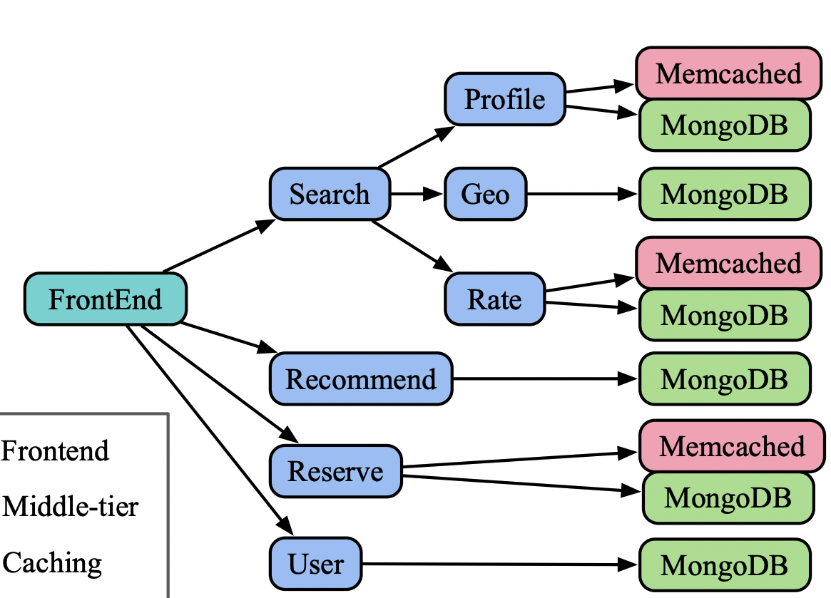
What dependencies to assume between entities?
Loses information about topological structure → poor accuracy
Infeasible to get a DAG in many cases
VM
Host
middle ground ?
ToR Switch
VM
Flow 1
VM
vNIC
vNIC
VM
ExplainIT, SIGMOD 2019
Sage, ASPLOS 2019
Sherlock, SIGCOMM 2007
Dependencies between entities:
None
Dependencies between entities:
Acyclic (DAG)
Notes:
Simplify that text. Spectrum is not coming across
Small text below the arrow. . Mention the word restrictive
- Existing works lie on a spectrum.
- On one end are systems such as ExplainIT which assume no dependencies.
However, assuming no dependencies loses information about topological structure about how these entities are organized and thus leads to poor accuracy.
On the other end are systems such as Sage or Sherlock which assume a perfect acyclic DAG of dependencies.
These DAGs define clearly which entities affect other entities and causality is only in one direction
Mention that this is related work slide, give citations
Show edges in DAG: have a more clearer picture

Slide 7
Cyclic dependencies among entities are the norm
Two reasons to model cyclic dependencies
True cyclic influences
Hard to infer dependency direction → over-approximate by assuming both directions
All application entities were involved in at least one cycle
Flow
ToR Switch
VMs → Host and Host → VMs
VMs also influence each other via flows
Flow
Flow
Flow
VM
VM
VM
VM
VM
VM
VM
VM
VM
VM
VM
VM
Host
vNIC
vNIC
vNIC
Host
vNIC
vNIC
Host
vNIC
vNIC
Host
vNIC
vNIC
vNIC
vNIC
vNIC
Notes:
We seek a middle ground here because in our environment, cyclic dependencies among entities are the norm. There are 2 reasons to model cyclic dependencies.
True cyclic influence between entities. Consider two VMs that reside on the same host. They affect the metrics of the host, but the host also affects the metrics of the VMs. Further, VMs affect each other via flows between them. Incorporating all these dependencies introduces cycles in the system.
Another reason to model dependencies is that even if the dependency is unidirectional, the direction of the dependency is hard to infer using coarse grained telemetry that’s available. Sowe over-approximate the dependency by assuming influence in both directions
Because of these 2 reasons, we found that in our environment, all application entities were involved in at least one cycle
TODO: change choice of colors; yellow is bad
e.g. two peer VMs affect each other indirectly via the host
In fact there can be cycles of dependencies b/w entities
Add edge in both directions → judge the strength in each direction from data

Slide 8
Murphy for performance diagnosis
Inputs
A problematic symptom
e.g. foo’s high CPU usage
Monitoring
information
Construct model of entities and dependencies
Find root causes in the model
Generate explanations
Output
Root cause with explanation
e.g. Root cause: Crawler machine
Crawler machine sent high requests to front-end
Which sent high requests to back-end
Which caused high load at the back-end
Notes:
We developed Murphy for Performance diagnosis incorporating some of these issues
Murphy takes as input a problematic symptom, which is specified by the operator and runs a 3 step analysis using commonly available monitoring information to produce its output

Slide 9
Murphy for performance diagnosis
Inputs
A problematic symptom
e.g. foo’s high CPU usage
Monitoring
information
Construct model of entities and dependencies
Find root causes in the model
Generate explanations
Output
Root cause with explanation
e.g. Root cause: Crawler machine
Crawler machine sent high requests to front-end
Which sent high requests to back-end
Which caused high load at the back-end
Notes:
The first step in the system is to construct a model of the entities and dependencies between them.

Slide 10
Construct model: Use “relationship graph” instead of causal DAG
Actual system
Relationship graph
Backend Servers
(thousands of entities)
ToR
Switch
Frontend
Server
Host
ToR Switch
vNIC
Crawler
Machine
Flow 1
Flow 3
Flow 3
Backend
VM
Flow 2
Host
VM
VM
VM
VM
VM
VM
VM
VM
VM
VM
VM
VM
Crawler
VM
Frontend
VM
Backend
VM
vNIC
Flow 1
Flow 2
Host
vNIC
vNIC
Host
vNIC
vNIC
Host
Host
vNIC
vNIC
vNIC
vNIC
vNIC
vNIC
vNIC
vNIC
vNIC
vNIC
Host
VM
Host
Edges based on loosely defined “neighborhood” relationship
  e.g. VM and its host, flow and its src, dst
Notes:
Add animations to edges when you mention VMs, bring up the VM edges

Slide 11
Construct model: Use “relationship graph” instead of causal DAG
Actual system
Relationship graph
Backend Servers
(thousands of entities)
ToR
Switch
Frontend
Server
Host
ToR Switch
vNIC
Crawler
Machine
Flow 1
Flow 3
Flow 3
Backend
VM
Flow 2
Host
VM
VM
VM
VM
VM
VM
VM
VM
VM
VM
VM
VM
Crawler
VM
Frontend
VM
Backend
VM
vNIC
Flow 1
Flow 2
Host
vNIC
vNIC
Host
vNIC
vNIC
Host
Host
vNIC
vNIC
vNIC
vNIC
vNIC
vNIC
vNIC
vNIC
vNIC
vNIC
Host
VM
Host
Edges based on loosely defined “neighborhood” relationship
  e.g. VM and its host, flow and its src, dst
Captures topological structure, while allowing cycles
Notes:
The idea here is instead of a causal DAG, we model the dependencies using a general ”relationship” graph.
The nodes in this graph are entities in the system
And the edges are based on loosely defined neighborhood relationship for e.g. we add an edge between VMs and their hosts, between flows and their endpoints and so on
Using a relationship graph allows us to capture the structure that’s naturally present among entities, while also allowing complex cyclic dependencies to be present

Slide 12
Murphy
Inputs
A problematic symptom
e.g. foo’s high CPU usage
Monitoring
information
Construct model of entities and dependencies
Find root causes in the model
Generate explanations
Output
Root cause with explanation
e.g. Root cause: Crawler machine
Crawler machine sent high requests to front-end
Which sent high requests to back-end
Which caused high load at the back-end
Notes:
The next step in the analysis is to find the root causes via this model

Slide 13
Which entity caused a problematic entity's anomalous metric?
ToR
Switch
Host
vNIC
Flow 3
Backend
VM
Problematic symptom:
(backend VM, high CPU)
Host
Crawler
VM
Flow 1
Frontend
VM
Flow 2
Backend
VM
vNIC
vNIC
vNIC
Host
VM
Host
How to infer root cause in this general relationship graph ?
Notes:
- Recall, that we want to find the entities responsible for the problematic symptom, in the relationship graph we constructed
- If we had a DAG of dependencies, it would be clear how entities affect the problematic symptom. But its not obvious in this graph
- Hence, we need a powerful inference algorithm to infer root causes in this relationship graph

Slide 14
Step 1: Learn a joint prob. distribution on all entity metrics
Toy example:
1 metric per entity
A
Markov Random Field (MRF)
P(A, B, C, D, E) = P[A | nbrs(A)] P[B | nbrs(B)]…
B
learnt via historical data prior to an incident
C
E
“ If neighbors(B) look like that, then what’s the likely value of B ? ”
D
Notes:
- The inference algorithm proceeds in multiple steps. The first step is to learn a joint prob. distribution on all entity metrics in the relationship graph.
But how do we learn the distribution, we don’t know which entity influences what? We use a Markov Random Field (MRF), which is a way to define a distribution on a general graph
And we learn this distribution via historical metrics, please see the paper for more details

Slide 15
Would changing A resolve D’s high value?
Pick a different value for A: A*
Toy example:
1 metric per entity
A
A → A*
B
C
E
D
Problematic symptom: D’s high CPU
Notes:
We can use the learnt distribution to determine if we change the value of A , what effect would it have on D and we can use this counterfactual analysis to get the root causes
This is how it works- we first pick a different value of A, say A* . It could be a lower value
Next we resample B using the distribution assuming the newer value of A
Similarly, we resample the other entities assuming the newer values we sample before
And we repeat this resampling a few times to propagate the effect of any cyclic effects
At the end, we obtain a new value for D which is the result of starting out with a different value for A
And if this new value is smaller than the original D, we can say that changing A would resolve D and hence can be a potential root cause\
Finally, to get all possible root causes, we can simply check the entire pool of candidate entities one by one

Slide 16
Would changing A resolve D’s high value?
Pick a different value for A: A*
Resample B* assuming A*
Toy example:
1 metric per entity
A
A → A*
B
B →B*
C
E
D
Problematic symptom: D’s high CPU

Slide 17
Would changing A resolve D’s high value?
Pick a different value for A: A*
Resample B* assuming A*
Similarly resample C*, E*, D*
Toy example:
1 metric per entity
A
A → A*
B
B →B*
C
E
C →C*
E →E*
D
D →D*
Problematic symptom: D’s high CPU

Slide 18
Would changing A resolve D’s high value?
Pick a different value for A: A*
Resample B* assuming A*
Similarly resample C*, E*, D*
Repeat 2, 3 a few times (Gibbs sampling)
Toy example:
1 metric per entity
A
A → A*
B
B →B’
C
E
C →C’
E →E’
D
D →D’
Problematic symptom: D’s high CPU
Notes:
We do this a few times to propagate the effects of the new values across dependency cycles.

Slide 19
Is A a root cause for D’s high value?
Pick a different value for A: A*
Resample B* assuming A*
Similarly resample C*, E*, D*
Repeat 2, 3 a few times (Gibbs sampling)
Toy example:
1 metric per entity
A
A → A*
B
B →B’
C
E
If D’ < D, then A is a root cause
C →C’
E →E’
D
D →D’
Iterate over all entities and check them one by one
Problematic symptom: D’s high CPU

Slide 20
Identify root causes in the relationship graph
ToR
Switch
Host
vNIC
Flow 3
Backend
VM
Problematic symptom:
(backend VM, high CPU)
Host
Crawler
VM
Flow 1
Frontend
VM
Flow 2
Backend
VM
vNIC
vNIC
vNIC
Host
VM
Host

Slide 21
Identify root causes in the relationship graph
ToR
Switch
Host
Potential
root causes
vNIC
Flow 3
Backend
VM
Problematic symptom:
(backend VM, high CPU)
Host
Crawler
VM
Flow 1
Frontend
VM
Flow 2
Backend
VM
vNIC
vNIC
vNIC
Host
VM
Host
Notes:
Using this analysis, Murphy concludes that these entities are the root causes for the problematic symptom.

Slide 22
Murphy
Inputs
A problematic symptom
e.g. foo’s high CPU usage
Monitoring
information
Construct model of entities and dependencies
Find root causes in the model
Generate explanations
Output
Root cause with explanation
e.g. Root cause: Crawler machine
Crawler machine sent high requests to front-end
Which sent high requests to back-end
Which caused high load at the back-end
Notes:
Finally, we attach simple explanations to the root causes to make Murphy’s output more interpretable to the operators

Slide 23
Generate explanations for the root causes: assign labels to entities based on current metric value
ToR
Switch
Host
vNIC
Flow 3
Backend
VM
Host
Crawler
VM
Flow 1
Frontend
VM
Flow 2
Backend
VM
vNIC
HEAVY HITTER
HEAVY HITTER
vNIC
vNIC
Host
HIGH DROP RATE
HIGH DROP RATE
Host
VM
DEGRADED PERFORMANCE
DEGRADED PERFORMANCE
NON-FUNCTIONAL
NON-FUNCTIONAL

Slide 24
Generate explanations for the root causes: causality rules between entity labels
ToR
Switch
Host
vNIC
Flow 3
Backend
VM
Host
Crawler
VM
Flow 1
Frontend
VM
Flow 2
Backend
VM
vNIC
HEAVY HITTER
HEAVY HITTER
vNIC
vNIC
Host
HIGH DROP RATE
HIGH DROP RATE
Host
VM
DEGRADED PERFORMANCE
DEGRADED PERFORMANCE
NON-FUNCTIONAL
NON-FUNCTIONAL

Slide 25
Generate explanation chains
(root cause → problematic symptom)
ToR
Switch
Host
Note this does not affect the root cause analysis
vNIC
Flow 3
Backend
VM
Host
HEAVY-HITTER
HEAVY-HITTER
HEAVY-HITTER
Crawler
VM
Flow 1
Frontend
VM
Flow 2
Backend
VM
vNIC
HEAVY-HITTER
vNIC
vNIC
HIGH DROP RATE
Host
Host
VM
Assign labels to entities based on their metrics
Notes:
The two flows are heavy hitters

Slide 26
Generate explanation chains
(root cause → problematic symptom)
ToR
Switch
Host
vNIC
Flow 3
Backend
VM
Host
HEAVY-HITTER
HEAVY-HITTER
HEAVY-HITTER
Crawler
VM
Flow 1
Frontend
VM
Flow 2
Backend
VM
vNIC
HEAVY-HITTER
vNIC
vNIC
HIGH DROP RATE
Host
Host
VM
Trace chain of influence from root cause to problematic symptom
Notes:
So we trace the chain of influence from the root cause to the problematic symptom and this serves as an explanation for the operator.
Note that you could not have done this if you didn’t have the structure of the entities.

Slide 27
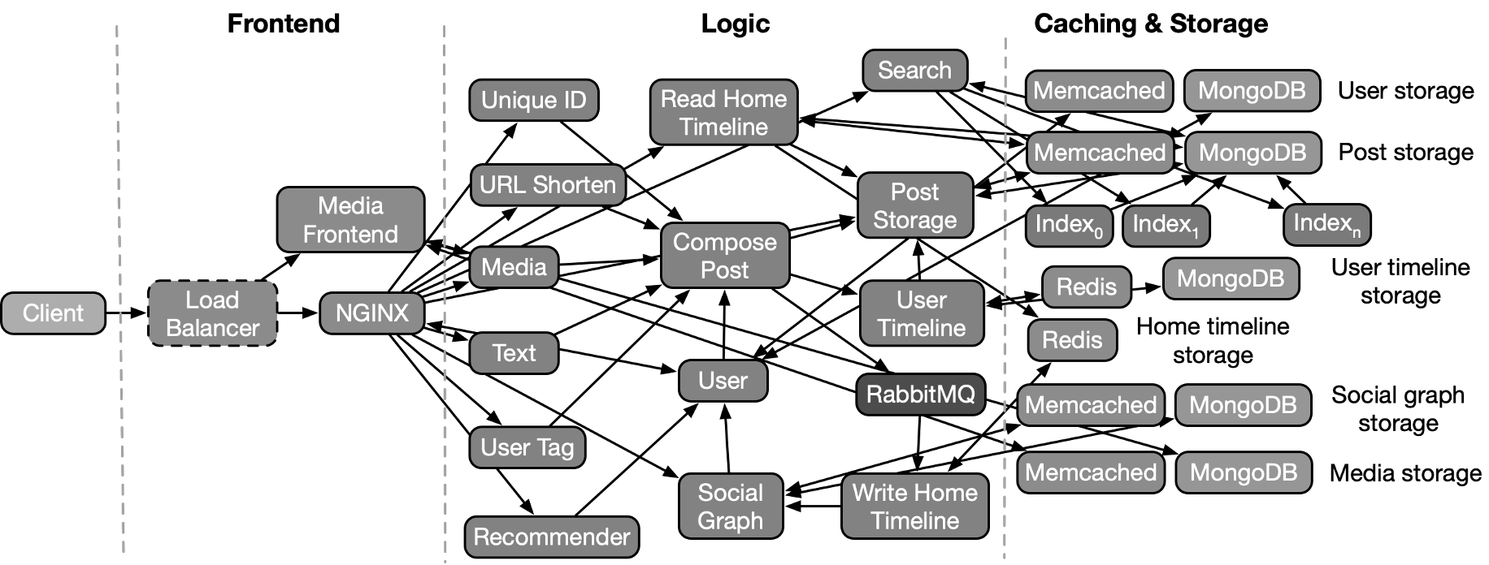
Evaluation
Scenario 1: with cyclic dependencies
  not captured by past work
  performance interference of one api on another in a distributed service
Scenario 2: does not have cyclic dependencies
  captured by past work
  resource contention on a container causes high latency to user
Created via DeathStarBench suite of microservice apps
Notes:
Pronounce suite

Slide 28

Scenario 1 (with cyclic dependencies): What’s the root cause for high latency of client 1?
API 2
Root cause
Common services
Client 2
API 1
Client 1
Problematic symptom: High response times for client 1
Notes:
So here is a scenario where you have client 1 who is experiencing high delay for its requests to API 1
And the root cause here is client 2 who is sending a lot of requests to API 2 and interferes with Client 1 because there are common downstream services that’s shared between the 2 APIs
Here you if only had a DAG, you would be able to model the effect between clients and services in one directions.
We need to model cyclic dependencies to capture the effect of client 2 on the common backend services and back from the services to client 1

Slide 29
Scenario 1 (with cyclic dependencies): What’s the root cause for high latency of client 1?
API 2
Common services
Root cause
Client 2
API 1
Client 1
Problematic symptom: High response times for client 1
Notes:
Visualize cycle, remove purple boxes, have larger arrows
So here is a scenario where you have client 1 who is experiencing high delay for its requests to API 1
And the root cause here is client 2 who is sending a lot of requests to API 2 and interferes with Client 1 because there are common downstream services that’s shared between the 2 APIs
Here you if only had a DAG, you would be able to model the effect between clients and services in one directions.
We need to model cyclic dependencies to capture the effect of client 2 on the common backend services and back from the services to client 1

Slide 30
Scenario 1 (with cyclic dependencies): Murphy finds the true root cause with good accuracy
Notes:
Murphy produced the correct root cause with high accuracy in this scenario whereas others performed poorly,

Slide 31
Scenario 2 (no cyclic dependencies): resource contention at a container results in high user response times
Problematic symptom: High response times for client
Root cause: this container
Notes:
Here’s a different scenario which doesn’t require capturing cyclic dependencies.
There’s a client who is experiencing high latency for its requests and the root cause is a container with resource contention on it.

Slide 32
Scenario 2 (no cyclic dependencies): Both Murphy and Sage do well
Notes:
- Murphy also does well here and is marginally better than Sage, probably because in our environment, we don’t have a lot training points for Sage’s neural networks
Clean up the graph, have labels next to the lines

Slide 33
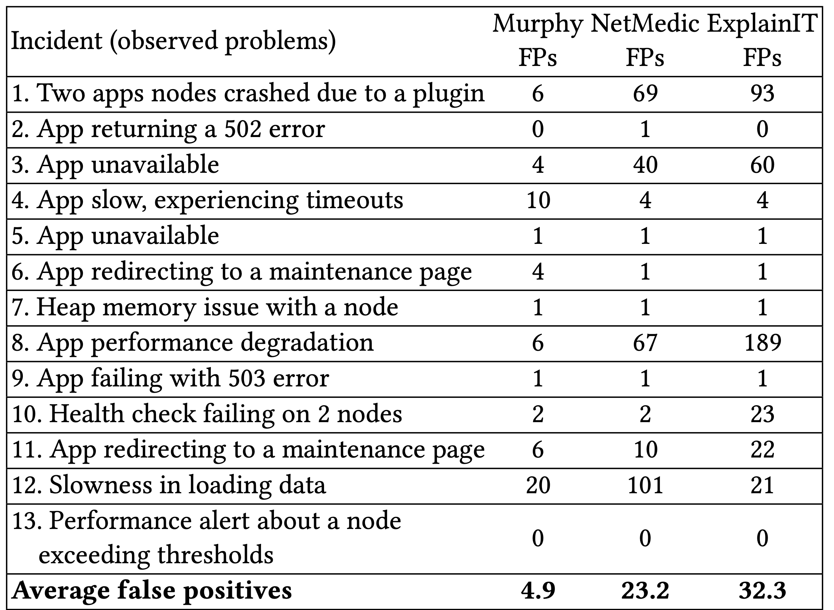
Production incidents in an enterprise environment
5x fewer false positives
Notes:
Finally, we ran Murphy on some production incidents and found that it produces 5x fewer false positives while producing the same level of false negatives

Slide 34
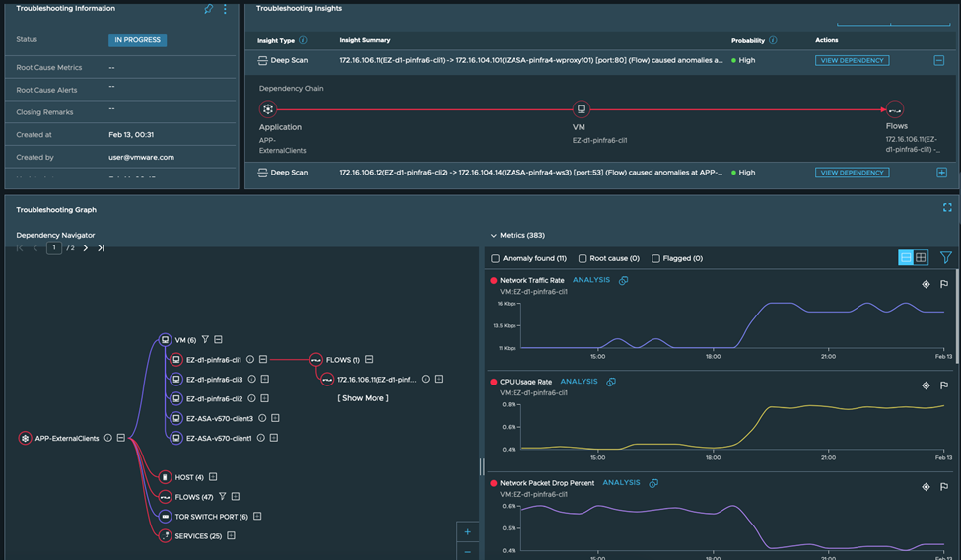
Murphy: Product adoption at VMware

Slide 35

Murphy for performance diagnosis
Uses a Markov Random Field (MRF) – framework
  can incorporate complex cyclic dependencies between entities
  learning algorithm uses common coarse-grained data
Check paper for more:
  accuracy when data has omissions
  model evaluation on a large dataset (300+ production apps)
  modeling cycles helps accuracy
Check out VMware’s blog post: https://shorturl.at/efvT2
  fault traces: https://github.com/netarch/Murphy-traces
Thank you!
Contact: vharsh2@illinois.edu
Notes:
Check out our blog post about commercial adoption.

Slide 36
Backup slides

Slide 37
What’s the root cause for high latency of client 2?
Relaxed accuracy: what if we relax the accuracy definition and give credit for partly helpful root causes?
Murphy has significantly better relaxed accuracy than others

Slide 38
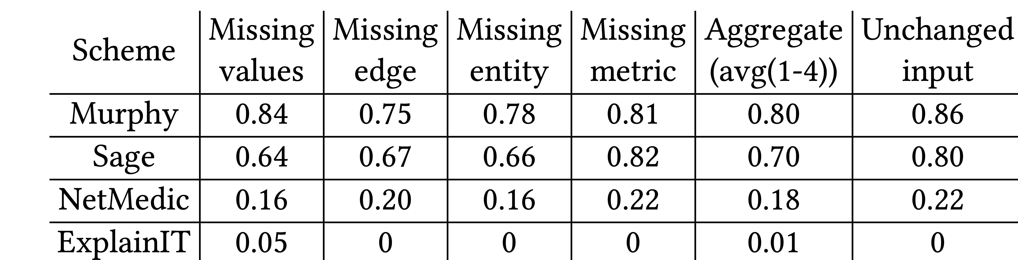
Real world telemetry often has omissions
What if some form of omissions exist in the telemetry data?
Murphy is resilient to these omissions
Notes:
Add some animation, text is too much to process

Slide 39
Filtering out correlated entities
ToR
Switch
Host
vNIC
Root cause
Problematic symptom:
(VM 1, high CPU)
Flow 3
VM 1
Host
Crawler
VM
Flow 1
Frontend
VM
Flow 2
VM 2
vNIC
vNIC
vNIC
Host
VM
Host
No significant chain of influence between correlated entities VM1 and VM2
Notes:
Using this analysis, Murphy concludes that these entities are the root causes for the problematic symptom.

Slide 40
Using Online learning
Training period
Operator invokes Murphy
Onset of incident
With online learning, some incident data is in the training set

